Slide 1

INSTITUTE :UIE
DEPARTMENT: ACADEMIC UNIT 4
Bachelor of Engineering (Non IT Branches)
Subject Name and Code:
Engineering Physics 23SPH-141
Prepared by: Anjana Sharma, Assistant Prof. Physics
CRYSTAL STRUCTURE & ULTRASONICS
DISCOVER . LEARN . EMPOWER

Slide 2
COURSE OBJECTIVES
The course is designed to make the students industry ready to contribute in the growing demand of the industry at local, national and international level.
It will make the students competent to understand basic concepts and applications of advanced engineering physics and apply its principles in their respective fields at global platform.
It will enhance the skill level of the students and shall make them preferred choice for getting employment in industry and research labs.
It will give thorough knowledge of the discipline to enable students to disseminate knowledge in pursuing excellence in academic areas.

Slide 3
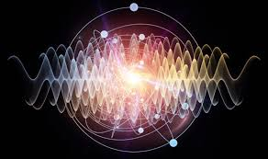
COURSE OUTCOMES
CO Number | Title On completion of this course, the students are expected to learn | Level
CO1 | To identify various components of laser and optical fibres and justify their importance and applications in different fields of science and technology | Understand Applying
CO2 | To explain the concept of oscillations and wave, compare the free, damped and forced oscillations, recognize the conditions of resonance and recommend its uses in various engineering fields and to describe the basic crystal structures, explain various methods for structural determination, list the properties of ultrasound wave and compare methods of its production and justify its properties in various applications. . | Understand Applying Analyze
CO3 | To explain the magnetic properties of materials and their applications and list the properties of nanomaterials, predict the changes in properties from bulk to nanoscale, compare various methods for their synthesis, identify the areas of its applications | Understand Applying
Fig. 1 Introduction [1]

Slide 4

ULTRASONIC PRODUCTION
Space for visual (size 24)
BY PIEZOELECTRIC METHOD
Fig. 2 Introduction [2]

Slide 5
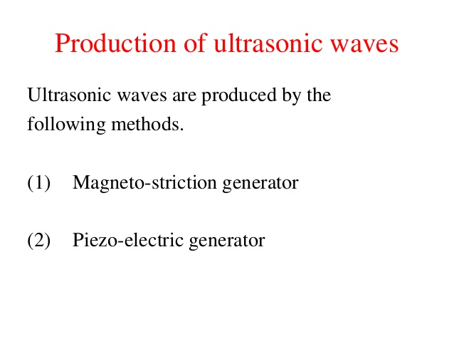
PRODUCTION OF ULTRASONIC WAVES

Slide 6
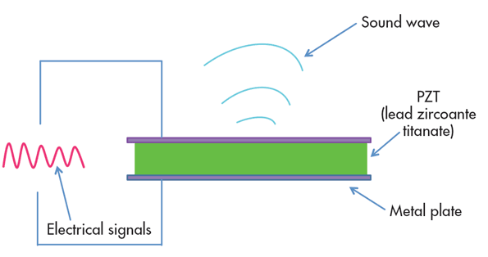
PIEZOELECTRIC METHOD
Fig. 3 Introduction [3]

Slide 7
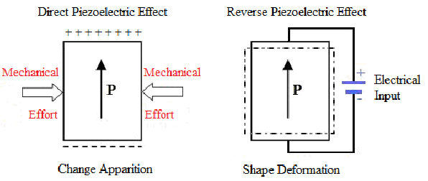
PRINCIPLE:- INVERSE PIEZO ELECTRIC EFFECT
This depends on the Inverse piezoelectric impact. At the point when a quartz precious stone is subjected to a rotating potential contrast along the electric pivot, the gem is set into versatile vibrations along its mechanical hub. On the off chance that the recurrence of electric motions harmonizes with the normal recurrence of the gem, the vibrations will be of huge plentifulness.

Slide 8
CONSTRUCTION
The circuit outline is appeared in the figure . It is base turned oscillator circuit. A cut of Quartz precious stone is set between the metal plates An and B in order to shape a parallel plate capacitor with the gem as the dielectric. This is coupled to the electronic oscillator through the essential curl L₃ of the transformer. Loops L₂ and L₁ of oscillator circuit are taken for the essential of the transformer. The authority curl L₂ is inductively coupled to base loop L₁. The curl L₁ and variable capacitor C shape the tank circuit of the oscillator.

Slide 9
WORKING
At the point when the battery is exchanged on, the oscillator delivers high recurrence motions. An oscillatory e.m.f is prompted in the curl L₃ because of transformer activity. So the precious stone is currently under high recurrence substituting voltage. The capacitance of C₁ is fluctuated so the recurrence of motions created is in reverberation with the regular recurrence of the precious stone. Presently the precious stone vibrates with bigger plentifulness because of reverberation. In this manner high power ultrasonic waves are created.

Slide 10
CONDITION FOR RESONANCE IN CIRCUIT
The frequency of the vibration is given by
where P
= 1,2,3,4 ... etc. for fundamental, first over tone, second over tone etc.,
Y = Young’s modulus of the crystal and
ρ = density of the crystal.
•The variable condenser C₁ is adjusted such that the frequency of the applied AC voltage is equal to the natural frequency of the quartz crystal, and thus resonance takes place.
•The vibrating crystal produces longitudinal ultrasonic waves of large amplitude.

Slide 11
ADVANTAGES AND DISADVANTAGES OF PIEZOELECTRIC METHOD
Advantages
Ultrasonic frequencies as high as 5 x 10⁸Hz or 500 MHz can be obtained with this arrangement.
The output of this oscillator is very high.
It is not affected by temperature and humidity.
Disadvantages
The cost of piezo electric quartz is very high
The cutting and shaping of quartz crystal are very complex.

Slide 12
SUMMARY
Introduction to Piezoelectric Method
Working of Piezoelectric Method
Advantages and Disadvantages
Application

Slide 13
FAQS
What is Magentostriction Method?
What is X-ray?
What are the advantages of Magentostriction method?
List disadvantages of Magentostriction method
What is the significance of Bragg’s law?
What is inverse piezoelectric method?

Slide 14
ASSESSMENT PATTERN
MST(02)
20 marks
Quiz
4 marks
Attendance
(>90%)
2 marks
Surprise test
4 marks
Assignment
10 marks

Slide 15
REFERENCES
[1] http://www.vidyarthiplus.in/2011/11/engineering-physics-1-ultrasonics-piezo.html
[2] http://www.brainkart.com/article/Piezo-Electric-Crystals---Principle,-Construction,-working,-Advantages-and-Disadvantages_6872/
[3] https://en.wikipedia.org/wiki/Crystal_oscillator
[4] https://www.youtube.com/watch?v=4nbBAG-848c
[5] https://www.thefreedictionary.com/Piezoelectric+oscillator
[6] https://silo.tips/download/production-of-ultrasonic-wave

Slide 16
THANK YOU
For queries
Email: anjana.e1643@cumail.in

